Slide 1

Program Design
Invasion Percolation: Background
Copyright © Software Carpentry 2010
This work is licensed under the Creative Commons Attribution License
See http://software-carpentry.org/license.html for more information.

Slide 2
Program Design

Slide 3
principles of
Program Design

Slide 4
principles of
Program Design

Slide 5
examples of
Program Design

Slide 6
examples of
Program Design
invasion percolation

Slide 7
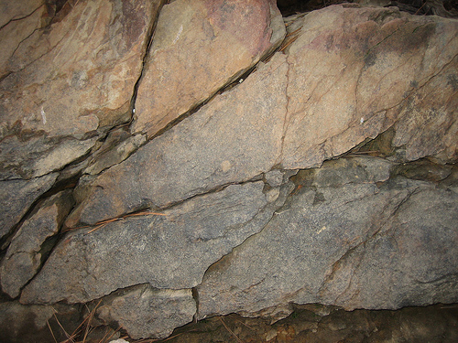
fractured rock
Notes:
Picture credit http://www.flickr.com/photos/lunchbox311/4167469955/

Slide 8
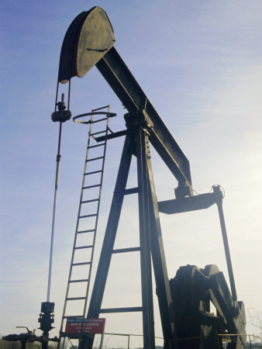
How far will pollution spread?
Notes:
Picture credit http://www.woodlandtrust.org.uk/en/campaigns/woodwatch/planning-system/scotland/PublishingImages/nodding-donkey.jpg

Slide 9
- 2D grid

Slide 10
- 2D grid
- Random values
5 | 3 | 7 | 2 | 6 | 1 | 1 | 3 | 4
8 | 5 | 6 | 5 | 7 | 2 | 3 | 6 | 2
2 | 5 | 8 | 7 | 5 | 5 | 6 | 5 | 9
5 | 2 | 6 | 4 | 9 | 3 | 9 | 6 | 5
4 | 6 | 8 | 8 | 5 | 9 | 7 | 3 | 9
7 | 6 | 4 | 5 | 1 | 2 | 6 | 8 | 5
5 | 4 | 2 | 5 | 8 | 5 | 5 | 5 | 8
5 | 7 | 5 | 1 | 5 | 3 | 8 | 5 | 5
4 | 5 | 1 | 9 | 7 | 8 | 6 | 5 | 1

Slide 11
- 2D grid
- Random values
- Fill center cell
5 | 3 | 7 | 2 | 6 | 1 | 1 | 3 | 4
8 | 5 | 6 | 5 | 7 | 2 | 3 | 6 | 2
2 | 5 | 8 | 7 | 5 | 5 | 6 | 5 | 9
5 | 2 | 6 | 4 | 9 | 3 | 9 | 6 | 5
4 | 6 | 8 | 8 | 5 | 9 | 7 | 3 | 9
7 | 6 | 4 | 5 | 1 | 2 | 6 | 8 | 5
5 | 4 | 2 | 5 | 8 | 5 | 5 | 5 | 8
5 | 7 | 5 | 1 | 5 | 3 | 8 | 5 | 5
4 | 5 | 1 | 9 | 7 | 8 | 6 | 5 | 1

Slide 12
- 2D grid
- Random values
- Fill center cell
- Examine neighbors
5 | 3 | 7 | 2 | 6 | 1 | 1 | 3 | 4
8 | 5 | 6 | 5 | 7 | 2 | 3 | 6 | 2
2 | 5 | 8 | 7 | 5 | 5 | 6 | 5 | 9
5 | 2 | 6 | 4 | 9 | 3 | 9 | 6 | 5
4 | 6 | 8 | 8 | 5 | 9 | 7 | 3 | 9
7 | 6 | 4 | 5 | 1 | 2 | 6 | 8 | 5
5 | 4 | 2 | 5 | 8 | 5 | 5 | 5 | 8
5 | 7 | 5 | 1 | 5 | 3 | 8 | 5 | 5
4 | 5 | 1 | 9 | 7 | 8 | 6 | 5 | 1

Slide 13
- 2D grid
- Random values
- Fill center cell
- Examine neighbors
- Fill lowest valued
5 | 3 | 7 | 2 | 6 | 1 | 1 | 3 | 4
8 | 5 | 6 | 5 | 7 | 2 | 3 | 6 | 2
2 | 5 | 8 | 7 | 5 | 5 | 6 | 5 | 9
5 | 2 | 6 | 4 | 9 | 3 | 9 | 6 | 5
4 | 6 | 8 | 8 | 5 | 9 | 7 | 3 | 9
7 | 6 | 4 | 5 | 1 | 2 | 6 | 8 | 5
5 | 4 | 2 | 5 | 8 | 5 | 5 | 5 | 8
5 | 7 | 5 | 1 | 5 | 3 | 8 | 5 | 5
4 | 5 | 1 | 9 | 7 | 8 | 6 | 5 | 1

Slide 14
- Repeat
5 | 3 | 7 | 2 | 6 | 1 | 1 | 3 | 4
8 | 5 | 6 | 5 | 7 | 2 | 3 | 6 | 2
2 | 5 | 8 | 7 | 5 | 5 | 6 | 5 | 9
5 | 2 | 6 | 4 | 9 | 3 | 9 | 6 | 5
4 | 6 | 8 | 8 | 5 | 9 | 7 | 3 | 9
7 | 6 | 4 | 5 | 1 | 2 | 6 | 8 | 5
5 | 4 | 2 | 5 | 8 | 5 | 5 | 5 | 8
5 | 7 | 5 | 1 | 5 | 3 | 8 | 5 | 5
4 | 5 | 1 | 9 | 7 | 8 | 6 | 5 | 1

Slide 15
- And repeat
5 | 3 | 7 | 2 | 6 | 1 | 1 | 3 | 4
8 | 5 | 6 | 5 | 7 | 2 | 3 | 6 | 2
2 | 5 | 8 | 7 | 5 | 5 | 6 | 5 | 9
5 | 2 | 6 | 4 | 9 | 3 | 9 | 6 | 5
4 | 6 | 8 | 8 | 5 | 9 | 7 | 3 | 9
7 | 6 | 4 | 5 | 1 | 2 | 6 | 8 | 5
5 | 4 | 2 | 5 | 8 | 5 | 5 | 5 | 8
5 | 7 | 5 | 1 | 5 | 3 | 8 | 5 | 5
4 | 5 | 1 | 9 | 7 | 8 | 6 | 5 | 1

Slide 16
- In case of tie...
5 | 3 | 7 | 2 | 6 | 1 | 1 | 3 | 4
8 | 5 | 6 | 5 | 7 | 2 | 3 | 6 | 2
2 | 5 | 8 | 7 | 5 | 5 | 6 | 5 | 9
5 | 2 | 6 | 4 | 9 | 3 | 9 | 6 | 5
4 | 6 | 8 | 8 | 5 | 9 | 7 | 3 | 9
7 | 6 | 4 | 5 | 1 | 2 | 6 | 8 | 5
5 | 4 | 2 | 5 | 8 | 5 | 5 | 5 | 8
5 | 7 | 5 | 1 | 5 | 3 | 8 | 5 | 5
4 | 5 | 1 | 9 | 7 | 8 | 6 | 5 | 1

Slide 17
- ...pick one at random
5 | 3 | 7 | 2 | 6 | 1 | 1 | 3 | 4
8 | 5 | 6 | 5 | 7 | 2 | 3 | 6 | 2
2 | 5 | 8 | 7 | 5 | 5 | 6 | 5 | 9
5 | 2 | 6 | 4 | 9 | 3 | 9 | 6 | 5
4 | 6 | 8 | 8 | 5 | 9 | 7 | 3 | 9
7 | 6 | 4 | 5 | 1 | 2 | 6 | 8 | 5
5 | 4 | 2 | 5 | 8 | 5 | 5 | 5 | 8
5 | 7 | 5 | 1 | 5 | 3 | 8 | 5 | 5
4 | 5 | 1 | 9 | 7 | 8 | 6 | 5 | 1

Slide 18
- Stop at edge of grid
5 | 3 | 7 | 2 | 6 | 1 | 1 | 3 | 4
8 | 5 | 6 | 5 | 7 | 2 | 3 | 6 | 2
2 | 5 | 8 | 7 | 5 | 5 | 6 | 5 | 9
5 | 2 | 6 | 4 | 9 | 3 | 9 | 6 | 5
4 | 6 | 8 | 8 | 5 | 9 | 7 | 3 | 9
7 | 6 | 4 | 5 | 1 | 2 | 6 | 8 | 5
5 | 4 | 2 | 5 | 8 | 5 | 5 | 5 | 8
5 | 7 | 5 | 1 | 5 | 3 | 8 | 5 | 5
4 | 5 | 1 | 9 | 7 | 8 | 6 | 5 | 1

Slide 19

Statistical properties
of the fractals produced
answer the original
question about
how far pollution
will spread.
Notes:
Picture credit http://www.fys.uio.no/faststoff/coop/coopphen_book97/images/cluster.gif

Slide 20
Need to do lots of simulations...

Slide 21
Need to do lots of simulations...
...on large grids

Slide 22
Need to do lots of simulations...
...on large grids
Program has to be fast

Slide 23
- How do we do it at all?

Slide 24
- How do we do it at all?
- How do we tell that it's correct?

Slide 25
- How do we do it at all?
- How do we tell that it's correct?
- How do we make it fast?

Slide 26
created by
Greg Wilson
May 2010
Copyright © Software Carpentry 2010
This work is licensed under the Creative Commons Attribution License
See http://software-carpentry.org/license.html for more information.

